Slide 1
Informed search algorithms

Slide 2
Outline
Best-first search
Greedy best-first search
A* search
Heuristics

Slide 3
Best First Search (Heuristic Search)
a greedy search
We evaluate a heuristic function.
Movement should be such that we move in a forward direction.
(1) Begin with a set of rules which are consistent and try to
arrive at a solution.
(2) User do not explicitly specify the sequence of use of rules.
Sequence of rules is decided by the KB (i.e. by the system).
In some way, the solution space should be explored.
AI systems attempt to get solution best in some sense (acceptable
solution), they do not attempt to get optimality. Solutions obtained
by AI systems may not be optimal.

Slide 4
The best does not mean optimal. Best is in heuristic sense.
Best alternative
dead end (not a goal)
This avoids searching completely. This is a Greedy algorithm.

Slide 5
The word heuristic comes from Greek word heuriskein meaning to discover.
Heuristic function is a function that gives a judgement from given stage to goal stage, e.g., nearest neighbor.
At each step of the best first search process, we select the most promising of the nodes we have generated so far. We then expand the chosen node by using the rules to generate its successors. If one of them is a solution, we then quit. If not, all those new nodes are added to the nodes generated so far. Again the most promising node is selected and the process continues.

Slide 6
Usually, what happens is that a bit of depth-first occurs as the most
promising branch is explored. But eventually, if a solution is not found,
that branch will start to look less promising than one of the top level
branches that had been ignored. At that point, the new more promising
previously ignored branch will be explored. But the old branch is not
forgotten. Its last node remains in the set of generated but unexpanded
nodes.The search can return to it whenever all the others get bad enough
that it is again the most promising path.

Slide 7
Best-first search
Idea: use an evaluation function f(n) for each node
estimate of "desirability“
Expand most desirable unexpanded node
Implementation:
Order the nodes in fringe in decreasing order of desirability
Special cases:
greedy best-first search
A* search

Slide 8
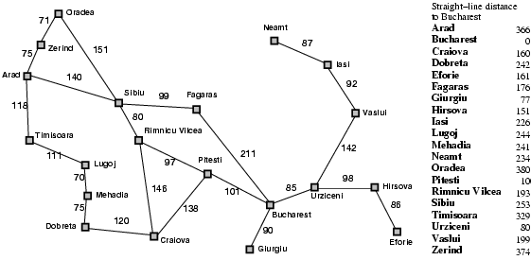
Romania with step costs in km

Slide 9
Greedy best-first search
Evaluation function f(n) = h(n) (heuristic)
= estimate of cost from n to goal
e.g., h_{SLD}(n) = straight-line distance from n to Bucharest
Greedy best-first search expands the node that appears to be closest to goal

Slide 10

Greedy best-first search example

Slide 11
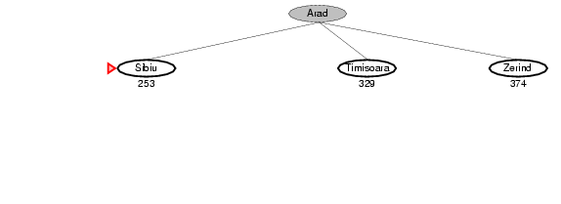
Greedy best-first search example

Slide 12
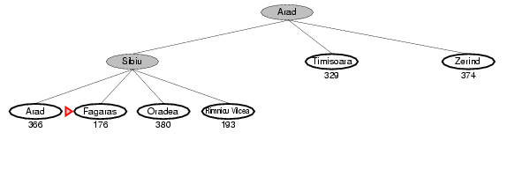
Greedy best-first search example

Slide 13
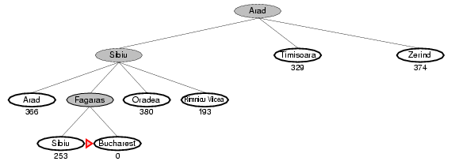
Greedy best-first search example

Slide 14
Properties of greedy best-first search
Complete? No – can get stuck in loops, e.g., Iasi → Neamt → Iasi → Neamt →
Time? O(b^{m}), but a good heuristic can give dramatic improvement
Space? O(b^{m}), keeps all nodes in memory
Optimal? No

Slide 15
A* search
Idea: avoid expanding paths that are already expensive
Evaluation function f(n) = g(n) + h(n)
g(n) = cost so far to reach n
h(n) = estimated cost from n to goal
f(n) = estimated total cost of path through n to goal

Slide 16

A* search example

Slide 17
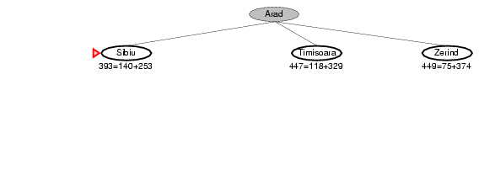
A* search example

Slide 18
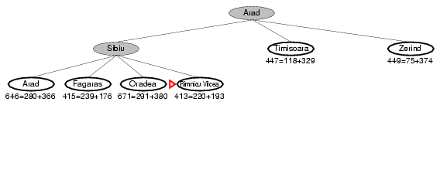
A* search example

Slide 19
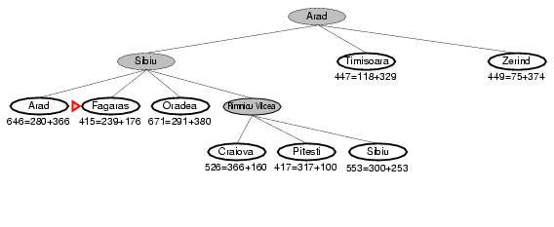
A* search example

Slide 20
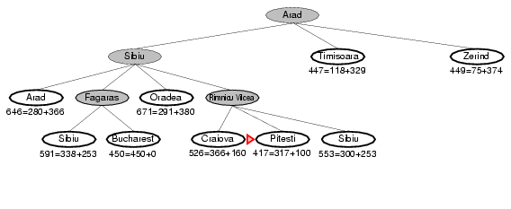
A* search example

Slide 21
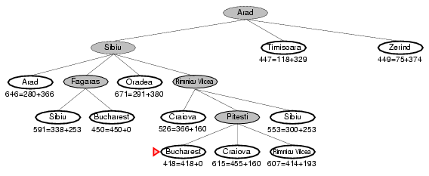
A* search example

Slide 22
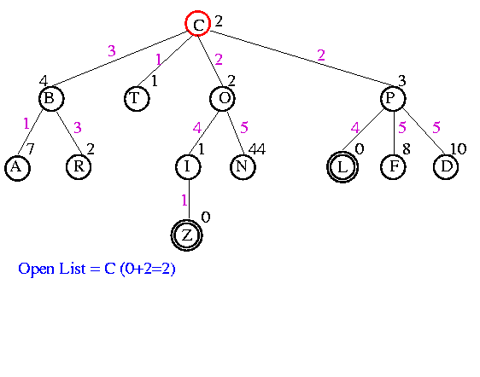
Example

Slide 23
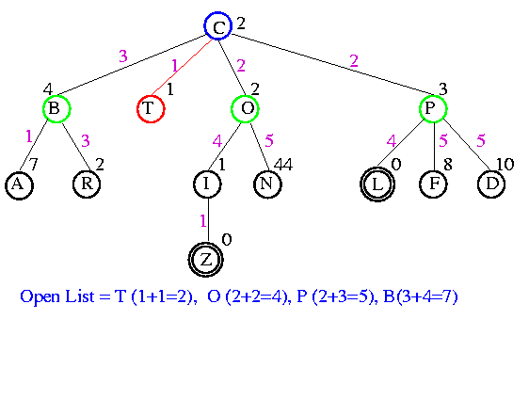
Example

Slide 24
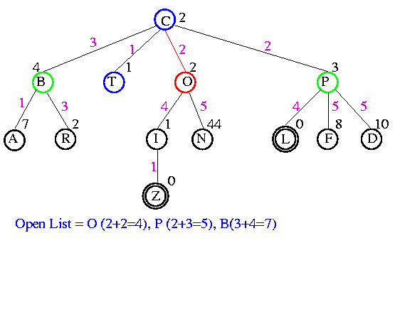
Example

Slide 25
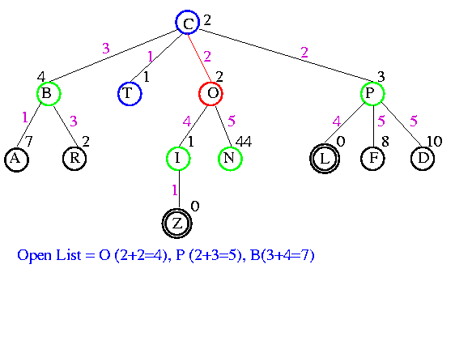
Example

Slide 26
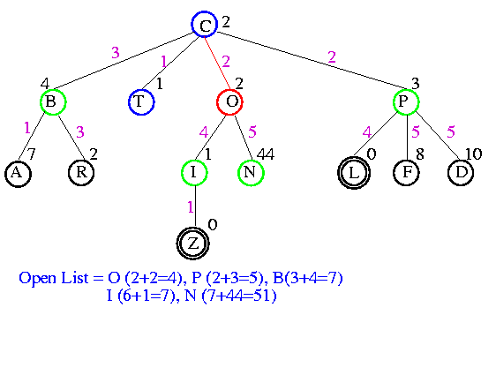
Example

Slide 27
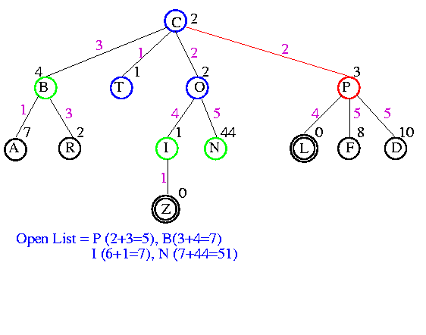
Example

Slide 28
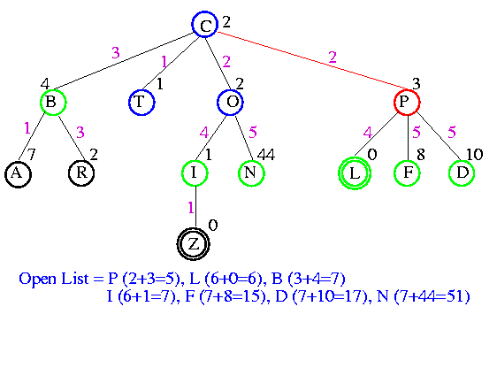
Example

Slide 29
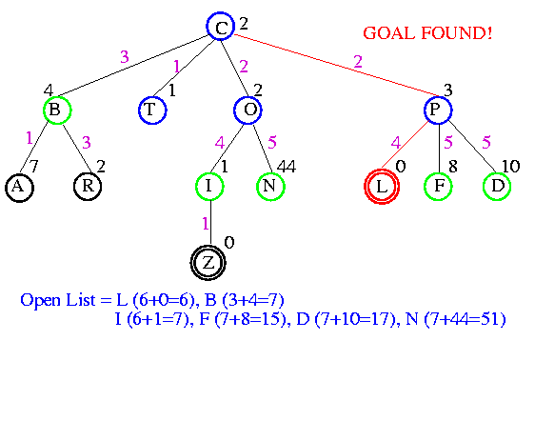
Example

Slide 30
Power of f
If heuristic function is wrong it either
overestimates (guesses too high)
underestimates (guesses too low)
Overestimating is worse than underestimating
A* returns optimal solution if h(n) is admissible
heuristic function is admissible if it never overestimates true cost to nearest goal
if search finds optimal solution using admissible heuristic, the search is admissible

Slide 31
Admissible heuristics
A heuristic h(n) is admissible if for every node n,
h(n) ≤ h*(n), where h*(n) is the true cost to reach the goal state from n.
An admissible heuristic never overestimates the cost to reach the goal, i.e., it is optimistic
Example: h_{SLD}(n) (never overestimates the actual road distance)

Slide 32
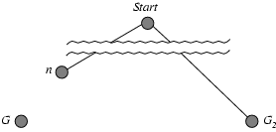
Theorem: If h(n) is admissible, A* using TREE-SEARCH is optimal
Suppose some suboptimal goal G₂ has been generated and is in the fringe. Let n be an unexpanded node in the fringe such that n is on a shortest path to an optimal goal G.
f(G₂) = g(G₂) since h(G₂) = 0
g(G₂) > g(G) since G₂ is suboptimal
f(G) = g(G) since h(G) = 0
f(G₂) > f(G) from above

Slide 33
Optimality of A* (proof)
Suppose some suboptimal goal G₂ has been generated and is in the fringe. Let n be an unexpanded node in the fringe such that n is on a shortest path to an optimal goal G.
f(G₂) > f(G) from above
h(n) ≤ h*(n) since h is admissible
g(n) + h(n) ≤ g(n) + h*(n)
f(n) ≤ f(G)
Hence f(G₂) > f(n), and A* will never select G₂ for expansion

Slide 34
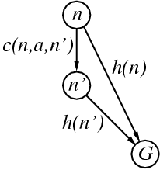
Consistent heuristics
A heuristic is consistent if for every node n, every successor n' of n generated by any action a, h(n) ≤ c(n,a,n') + h(n') Suppose n' is a successor of n then
g(n') = g(n) + c(n,a,n')
If h is consistent, we have
f(n') = g(n') + h(n')
= g(n) + c(n,a,n') + h(n')
≥ g(n) + h(n)
= f(n) i.e., f(n) is non-decreasing along any path.
Theorem: If h(n) is consistent, A* using GRAPH-SEARCH is optimal

Slide 35
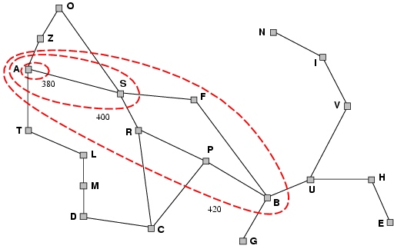
Optimality of A*
A* expands nodes in order of increasing f value
Gradually adds "f-contours" of nodes
Contour i has all nodes with f=f_{i}, where f_{i} < f_{i+1}

Slide 36
Properties of A*
Complete? Yes (unless there are infinitely many nodes with f ≤ f(G) ) Time? Exponential
Space? Keeps all nodes in memory
Optimal? Yes

Slide 37
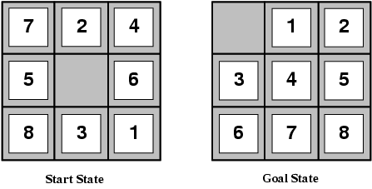
Admissible heuristics
E.g., for the 8-puzzle:
h₁(n) = number of misplaced tiles
h₂(n) = total Manhattan distance
(i.e., no. of squares from desired location of each tile)
h₁(S) = ?
h₂(S) = ?

Slide 38
Admissible heuristics
E.g., for the 8-puzzle: h₁(n) = number of misplaced tiles
h₂(n) = total Manhattan distance
(i.e., no. of squares from desired location of each tile)
h₁(S) = ? 8
h₂(S) = ? 3+1+2+2+2+3+3+2 = 18

Slide 39
Dominance
If h₂(n) ≥ h₁(n) for all n (both admissible)
then h₂ dominates h₁
h₂ is better for search
Typical search costs (average number of nodes expanded):
d=12 IDS = 3,644,035 nodes A*(h₁) = 227 nodes A*(h₂) = 73 nodes
d=24 IDS = too many nodes A*(h₁) = 39,135 nodes A*(h₂) = 1,641 nodes

Slide 40
Generating Heuristic Functions
Generate heuristic using simpler (relaxed) problem
Relaxed problem has fewer restrictions
Cost of optimal solution to relaxed problem is an admissible heuristic for the original problem
If the rules of the 8-puzzle are relaxed so that a tile can move anywhere, instead of just to the adjacent empty square, then h1(no. of misplaced tiles) would give the exact number of steps in the shortest solution.
If the rules are relaxed so that a tile could move one square in any direction, even onto an occupied square (any adjacent square), then h2 (Manhattan distance) would give the exact number of steps in the shortest solution.
Learn heuristic from experience

Slide 41
Best-first search for Graphs
Each node will contain
a description of the problem state it represents
an indication of how promising it is
a parent link that points back to the best node from which it came
a list of nodes that were generated from it.
The parent link will make it possible to recover the path to the goal once the goal is found.
The list of successors will make it possible. If a better path is found to an already existing node, to propagate the improvement down to its successors.

Slide 42
This type of graph is called an OR graph, since each of its branches represent an alternative problem-solving path.
To implement such a graph search procedure, we need to use two list of nodes.
OPEN- list of nodes(generated and heuristic function calculated) in
form of a priority queue with the highest priority of those
nodes with the most promising value of the heuristic
function.
CLOSED - nodes that have already been examined We need to
keep these nodes in memory if we want to search a graph
rather than a tree, since whenever a new node is generated,
we need to check whether it has been generated before.

Slide 43
Evaluation function
f(n) = g(n) + h(n)
g(n) = cost so far to reach node n from the initial node
h(n) = estimated cost from node n to goal
f(n) = estimated total cost of path through node n to goal

Slide 44
Algorithm : Best-First Search
1. Start with OPEN containing the initial state.
2. Until a goal is found or there are no nodes left in OPEN do
(a) Pick the best node in OPEN.
(b) Generate its successors.
(c) For each successor do
(i) if it has not been generated before, evaluate it,
add it to OPEN and record its parents.
(ii) if it has been generated before, change the
parent if this new path is better than the
previous one.

Slide 45
In that case, update the cost of getting to this
node and to any successors that this node
may already have.

